Slide 1
Saving and Investing for Your Future
Notes:
Introduction.

Slide 2
SEC Disclaimer
The SEC’s Office of Investor Education and Advocacy is providing this information as a service to investors. This presentation is not a statement of official SEC policy, a legal interpretation, or investment advice.
Notes:
We are required to give this disclaimer before we speak to audiences.
We are not providing legal advice or investment advice today. Instead, we’re talking about general principles of sound investing and avoiding fraud.

Slide 3
Today’s Topics
Managing Debt and Credit
Saving and Investing
Investment Products
Planning for Retirement
Tips to Avoid Fraud
Notes:
Here’s what we’ll cover today:
We’ll talk a little about managing debt and making smart use of credit.
Then, we’ll talk about strategies for saving and investing.
We’ll discuss some ideas on how to plan for retirement, including a discussion of employer-based and individual retirement investment options.
And finally, we’ll go over tips to protect your money from fraudsters.

Slide 4

Investor.gov
Play video
Notes:
But first, a short reminder that if you have questions about investing, the SEC’s website, Investor.gov, has answers.

Slide 5
Managing Debt and Credit
Notes:
Let’s start at the beginning: Before we can invest, we have to get debt and spending under control.
One of life’s truisms is that debt is easy and fun to rack up, but not so fun to pay off. The best advice is to always be careful and wise about the use of credit.
However, if your debt is a burden, you need a plan. And that plan is simple to say, but tough to do: Stop spending too much and start paying down that debt as aggressively as you can afford.
That likely means you have to pay more than the minimum payment every month.
It doesn’t make sense to invest in a mutual fund that may return 8% if you are paying monthly interest of 18% or more to a credit card company for a revolving balance.
That’s why we should pay down high interest debt first before we can clear the decks for investing.

Slide 6

Knowing the Cost of Credit
2021: $2000 2026: $2850
Paid in full up front
Paid only $50 each month
Notes:
Paying off debt over a long period of time costs you money.
Take the example of this high-end laptop. If you only pay $50 each month, the laptop will end up costing nearly 50% more and it will take you almost 5 years to pay off, by which time it will probably be obsolete.
No investment strategy pays off as well as, or with less risk than, eliminating high interest debt. Most credit cards charge high interest rates -- as much as 18% or more - if you don’t pay off your balance in full each month.
FOR REFERENCE: This example assumes a 16% APR and a payment of $50 each month with no additional fees/charges incurred.

Slide 7

Pay Off High-Interest Debt
The interest you pay every month to credit card companies can be higher than the amount that investments may earn
Notes:
Before you invest, make sure you aren’t saddled with high interest debt like credit cards.
If you carry a revolving balance – meaning you can’t afford to pay off your credit card bill at the end of the month – then you may be paying out interest to the bank that is significantly higher than the interest you could earn with an investment like the TSP.
Get your credit cards and high interest debt under control before so you can begin investing.

Slide 8

Ideal Debt/Credit Cycle
Pay debt
Establish credit
Improve score
Incur debt
Notes:
How many of you think credit cards are a good thing? Bad?
In fact, there are pros and cons to credit cards.
Pros:
Credit cards can come in handy in emergencies – you can incur the expense now, but pay it off over time.
Ironically, you have to incur some debt to establish a credit history.
With an established credit history and higher credit score, you may ultimately be able to obtain loans at lower interest rates, which means lower cost.
Cons:
You may overspend with a credit card, and debt allows you to live beyond your means artificially (and temporarily).
It gives you a false sense of security.
Carrying debt means that you spend money on interest and fees.

Slide 9
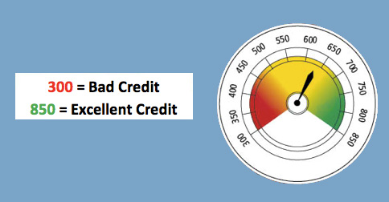
Credit Score = Financial Barometer
Higher Scores = Lower Payments
Notes:
Your credit score—a number between 300 and 850—is the financial barometer that measures the creditworthiness and risk potential of an individual consumer.
It’s one of the tools used by banks and lenders to determine the interest rate you’ll pay on a given loan. The higher your credit score, generally the lower the interest rate charged, and the lower your payments. A higher score also makes it easier to be approved for new lines of credit, such as a mortgage or car loan.
Your credit score may also come into play in other situations, such as when applying for a new job or renting an apartment.

Slide 10
Impact of Credit Score
$200,000 30-Year Mortgage
Score of 760-850
Rate: 2.337%
Monthly payment: $773
Final cost of payments:
$278,000
Score of 620-639
Rate: 3.926%
Monthly payment: $946
Final cost of payments:
$341,000
Notes:
Look at the impact of two credit scores on a 30-year-fixed mortgage for the same amount of $200,000:
Credit score of 760 – 850; Rate of 2.3%; Monthly payment of $773
Credit score of 620 – 639; Rate of 3.9%; Monthly payment of $946
Bottom line: after 30 years, the person on the right would pay almost $63,000 more for the same house. And it’s all because his credit score was impaired at the time he went to get the mortgage. Source: Rates at MyFico.com; Google Mortgage Calculator

Slide 11
Tips to Improve Your Credit Score
Pay your bills on time, every time
Don’t get close to your credit limit
A long credit history will help your score
Only apply for credit that you need
Check your credit report regularly and make sure the information is correct at AnnualCreditReport.com
Source: CFPB www.consumerfinance.gov
Notes:
AUDIENCE QUESTION: What are steps you can take to improve your credit score?
Pay all of your credit cards and other debts on time.
Reduce the balance on your credit cards. Pay off your credit card every month, and avoid paying only the minimum payment required.
Do not get too many lines of credit, especially at the same time, but keep the ones you have for as long as possible. (Applications generate inquiries.)
Review your credit reports to check for errors: www.annualcreditreport.com

Slide 12
Saving and Investing

Slide 13



Smart Money Management Begins with Saving
Saving is important for:
Emergencies
Education
Big Purchases
Family
Notes:
Why do we save?
Audience question: What are some things that you’re saving for or that you plan to save for?
Do you want to own a home some day? Open a business? Start a family? Those are long-term savings goals.
In addition to long-term plans, you also need an emergency fund to cover unexpected shocks, like a major car repair, a house repair or a health crisis.
These things can require money in a hurry, and surveys have shown that many are unprepared to incur an unexpected expense.
As the name implies, “savings” are generally put into safe places that allow for easy access, such as a savings account with a bank or credit union.

Slide 14

Emergency Fund
Save enough to have a buffer for life’s unexpected expenses:
Set a savings goal, such as 3-6 months of living expenses
Take advantage of one-time opportunities, such as tax refunds or bonuses
Save automatically, such as by setting up a direct deposit to a savings account with each paycheck
Notes:
The Federal Reserve conducted a study that showed that nearly 4 in 10 Americans do not have enough money saved to cover an unexpected expense of $400. That could be a minor car repair or a cracked screen on your phone.
Even a small financial shock can turn into long-term debt if you don’t have an emergency fund.
Consider direct-depositing a small amount of each paycheck into your savings account, and take advantage of special opportunities to pump up your savings, like a tax refund or gift money.
Try to work toward a goal of having a few months’ worth of living expenses saved in an emergency fund – it will make you less likely to go into debt if life throws you a curveball.
Source: https://www.federalreserve.gov/publications/2019-economic-well-being-of-us-households-in-2018-dealing-with-unexpected-expenses.htm

Slide 15


Why Not Just Save?
1996 Ford Mustang
Convertible GT
$23,495 MSRP
99% INCREASE
2021 Ford Mustang
Convertible GT
Starting at $46,815
Source: Autotrader.com
Source: Autotrader.com
Notes:
You can’t just put all your money into savings – or stick it under the mattress – because the money you have today won’t have the same purchasing power for what you need later on. Prices for goods and services go up over time – it’s called inflation.
Let’s look at an illustration of inflation – the cost of a Ford Mustang GT 2-door convertible. In 1996, it cost around $23,495.
In 2021, it will run you nearly than $47,000. That’s a 99% increase in price over those 25 years.
That’s the result of inflation.
And inflation also impacts higher education costs, housing costs, food and consumer goods, and everything we need to live. So to keep up with inflation, you have to make your money grow. And that’s what we’re here to talk about – investing.

Slide 16
Saving vs. Investing
Saving:
The money you earn but don’t spend
Investing:
Making that money grow
Notes:
Savings is all the money you earn but don’t spend. Investing is slightly different – it means making that money grow.
The key difference between the two is that investing has risk, but it also has a potential to earn higher returns. What does your bank pay you in interest to keep money in a savings account? 1% maybe? The money you have in a bank account may not grow much, but it will be safe since it’s FDIC insured.
So why might we want to take on more risk? Why might we want to invest?

Slide 17
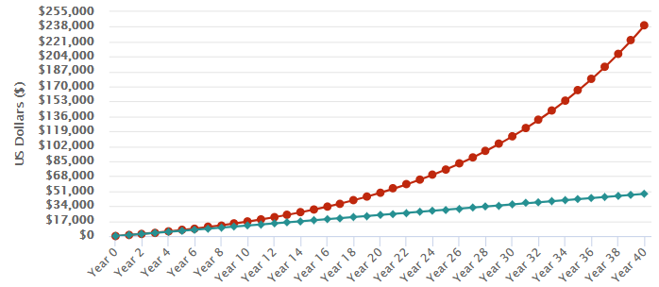
Example of Compound Growth
Value at 40 years:
$239,562
$100/month
$48,000 contributed
7% average annual growth
Notes:
How do investments keep up with inflation? It’s through growing over time thanks to the the power of compounding. Over time, that growth snowballs.
Imagine that at 25 years old, you started investing $100 a month for the next 40 years. After 40 years, you would have invested $48,000, but thanks to the power of compounding, the money you invested would have grown to $239,562, assuming a 7% annual return. That’s about 5 times more than you contributed!
By starting early and using the power of compounding, you’re putting your money to work for you.
Source: Investor.gov compound interest calculator

Slide 18
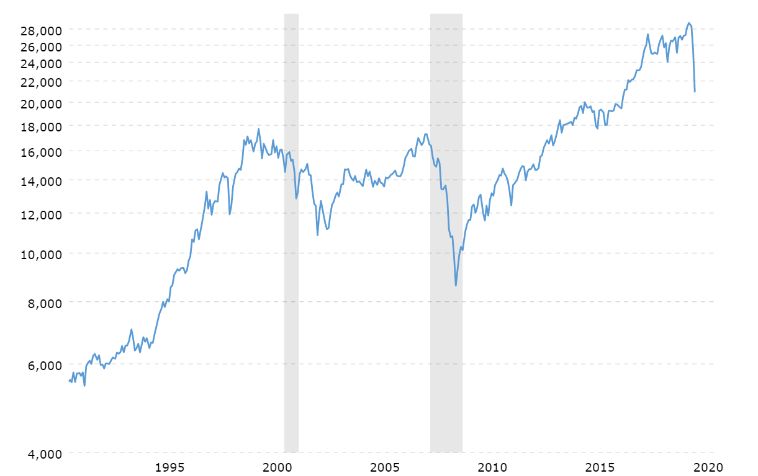
Dow Jones Over 30 Years
Notes:
That doesn’t mean that the growth is consistent! This graph shows a benchmark of the stock market’s performance known as the Dow Jones Industrial Average over the course of 30 years, from 1990 to 2020. You can see that the index has had many ups and downs. But look at the long term trend – historically the performance of stocks has trended positive.
Keep in mind:
Short-term stock performance tends to be volatile (jagged on the chart), but take a look at the long-term trend.
Stock returns (historically) do well over time (on average approx. 7-9% per year), but as you can see on the slide, the performance isn’t smooth and consistent
Chart source: Macrotrends (https://www.macrotrends.net/1319/dow-jones-100-year-historical-chart)
Chart date: March 15, 2020

Slide 19
The Power of Starting Early
The earlier you start, the less money you need to invest to reach your goals
 | $250,000 by 65 | $500,000 by 65
Age 25 | $104/month | $209/month
Age 35 | $221/month | $441/month
Age 45 | $508/month | $1,016/month
Age 55 | $1,508/month | $3,016/month
Assumes 7% rate of growth Source: Investor.gov Savings Goal Calculator
Notes:
Thanks to the power of compound growth, one of the best ways to build wealth is by saving and investing over a long period of time.
The earlier you start, the easier it is for your money to grow, which means it takes less money to reach your goals.
Here’s how much you’d need to save each month if your retirement goal was $250,000 or $500,000 depending on the age you started investing.

Slide 20

Automate Your Saving and Investing
$5,176 after 5 years
$12,435 after 10 years
$36,896 after 20 years
$75 per
month
Notes:
Most of us don’t think anything of automating payments with our monthly subscription and streaming services. We can apply this concept to saving and investing. It helps to do your saving and investing automatically. You can set it up with your bank to have the money sent directly to a savings or investment account, such as a mutual fund account. In other words, set it and forget it.
This creates the habit of saving and allows the power of compounding to work for you over time.
This slide assumes a 7% average annual rate of return – and, of course, stock market returns can vary greatly year to year.
Source: Investor.gov Compound Interest Calculator.

Slide 21
Investment Products

Slide 22

All Investments Have…
Notes:
Rule number one of investing is that all investments have risk.
But if you are a long-term investor in the US markets, you have historically done well.

Slide 23
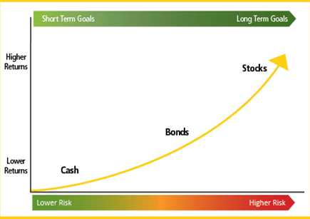
Investment Risks/Returns
Short-Term Goals Long-Term Goals
Stocks
Bonds
Cash
Lower Risk Higher Risk
Notes:
In investing, the potential for higher return typically comes with higher risk.
Different investments have different risks, and the potential for greater return generally comes with higher risk. Look how we move from safer-but-lower-return cash at the bottom up to riskier-but-higher-return stocks.

Slide 24

Stocks
Stocks, also called “equities,” give stockholders a share of ownership in a company
Benefits:
Share price can increase
Some stocks can pay dividends
Ability to vote shares
Risks:
Share price can decrease
Companies can go bankrupt
Notes:
Stocks are shares of ownership in a company.
Stocks have historically offered the greatest potential for returns. A stock can appreciate in price and some stocks can pay dividends if the company distributes its earnings to stockholders.
Stocks can lose value, however, and companies can even go bankrupt, leaving their stock worthless.

Slide 25

Bonds
Bonds are like loans you make to a government or corporation on which you receive interest payments for a period of time
Benefits:
Predictable income stream
Return of principal after bond matures
Risks:
Inflation risk
The issuer may “call” the bond
Issuers may go bankrupt
Notes:
Bonds are like IOUs: I lend money to a company or government body, and they promise to pay me back in a certain period of time. In the meantime, I can get a predictable income stream from the interest payments.
Some of the benefits of bonds are:
They provide a predictable income stream. Typically, bonds pay interest twice a year.
If the bonds are held to maturity, bondholders get back the entire principal, so bonds are a way to preserve capital while investing.
Bonds can help offset exposure to more volatile stock holdings.
Some of the risks include:
Interest rate changes can affect a bond’s value. If bonds are held to maturity, the investor will receive the face value, plus interest. If sold before maturity, the bond may be worth more or less than the face value. This is called interest rate risk.
The bond issuer may pay you the bond’s face value before the bond’s maturity date. This means that you would stop receiving the interest payments. This is something an issuer might do if interest rates decline. This is called call risk.
The issuer may fail to timely make interest or principal payments and thus default on its bonds. This is called credit risk.

Slide 26
Mutual Funds and Exchange-Traded Funds (ETFs)
Pools of money invested by an investment company in stocks, bonds or other securities – or some combination of those investments
Benefits:
Diversification, professional management, affordability
Risks:
  Typically the same as the underlying securities
Notes:
Mutual funds and ETFs are a way to invest in the stock market without purchasing individual securities. Many workplace retirement plans, like 401(k)s, offer a selection of mutual fund investments to employees.
The main benefits of mutual funds and ETFs are:
Professional Management. The fund managers do the research for you. They select the securities and monitor the performance.
Diversification or “Don’t put all your eggs in one basket.” Mutual funds typically invest in a range of companies and industries. This helps to lower your risk if one company fails.
Affordability. Most mutual funds set a relatively low dollar amount for initial investment and subsequent purchases.
Remember that all investments carry some level of risk – typically the same as the underlying securities.

Slide 27
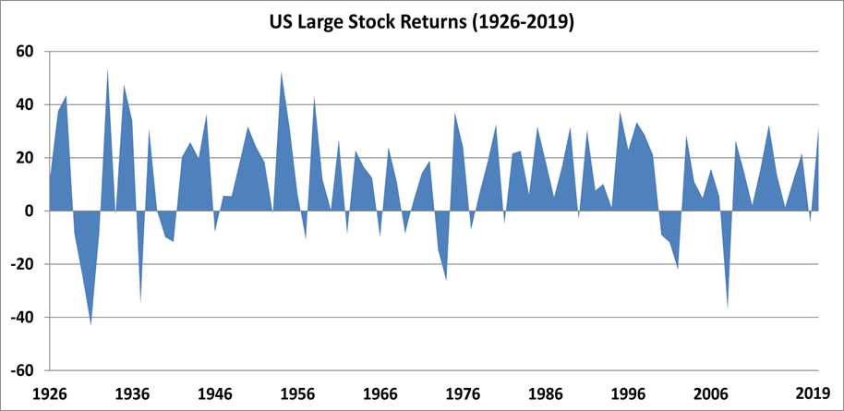
Time: Friend or Foe?
U.S. Large Stock Performance (1926-2019)
Notes:
Audience Question: What stands out the most when you look at this chart?
Lots of volatility (i.e. ups and downs)
There are significant downs (the most prominent represent the 1929 Stock Market Crash, the Great Depression Banking Panic, WWII, the Oil Shock, Dotcom Crash and the recent Financial Crisis/Great Recession)
Its mostly up: Despite inevitable down periods the long-term trend of the market is positive. Historically the long-term average rate of return for the S&P 500 is between 8-10%.
Therefore, if you have a long time horizon for your investments, you can capture the historical averages of the market by investing for the long term and ignoring the volatility and daily fluctuations.
However, it is important to note that this also demonstrates that the shorter your time horizon on your investments, the more volatility becomes relevant. For example, if someone in 2006 planned to retire in the next few years but had all their investments in stocks, they would have been seriously hurt in the downturn in 2008 and likely would have been prevented from retiring at that time. This teaches us that as you get closer to your target date (e.g. retirement), it is important to shift your asset allocations to reflect your changing risk tolerance (e.g. increasingly shift portions of your portfolio away from stocks to less volatile asset classes such as bonds).
It is useful to refer back to this slide later in the presentation when discussing target date funds/TSP Lifecycle funds, and the concept of asset class allocation and how that shifts as risk tolerance changes the closer one gets to their target date.

Slide 28

Managing Risk
Manage risk with asset allocation and diversification
Notes:
In the chart earlier, we saw the risks of various investments.
The best way to manage investment risk is to allocate your assets and diversify your investments.
In other words, put your money in different asset classes -- and within the different asset classes, include different investments (e.g., domestic, international, large cap, small cap) so that if one investment performs poorly, another might do well.
In short, don’t put all of your eggs in one basket.

Slide 29
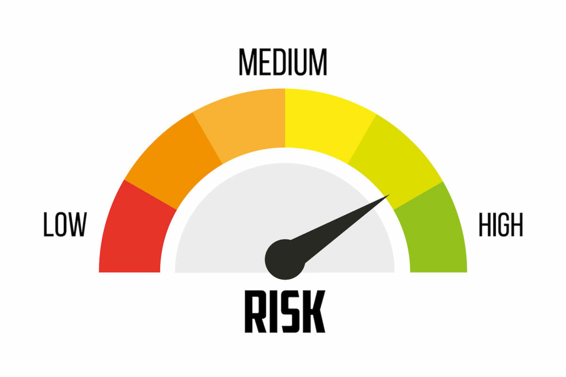

Asset Allocation
Asset allocation involves dividing an investment portfolio among different asset categories, such as stocks, bonds, and cash
Time Horizon
Risk Tolerance
Notes:
Asset allocation is deciding how to divide an investment portfolio among different assets, such as stocks, bonds and cash.
To decide how to allocate your assets, you may want to consider your time horizon (how long until you will need the money) and your risk tolerance (how much risk do you want to take).
Generally speaking, the longer you have to invest before you will need your money, the more risk you can afford to take on.

Slide 30
Longer-Term Goals and Shorter-Term Goals
Notes:
Audience question: Why do you think the sample 2050 portfolio contains mostly stocks?
Because this sample portfolio is for a goal far in the future, it is more heavily invested in stocks, which are riskier than bonds and cash. That’s because like we discussed earlier, the longer your time horizon, the more risk you can generally afford to take.
Audience question: What do you think a 2025 portfolio might look like? Do you think it would it have more or less stocks? Why?
The sample 2025 portfolio is more heavily invested in bonds and cash, which are less risky than stocks. The more conservative allocation helps to preserve the money because it will be needed sooner.

Slide 31
Explanation of diversification
Notes:
You should also spread your money among different investments within each asset class. This is called diversification, and it means holding a mix of different stocks or bonds. One way to diversify would be to hold stocks in a variety of industry sectors, such as consumer goods, health care, and technology. Diversification helps investors to manage risk because if one company or industry sector experiences a decline in value, others may post gains.

Slide 32
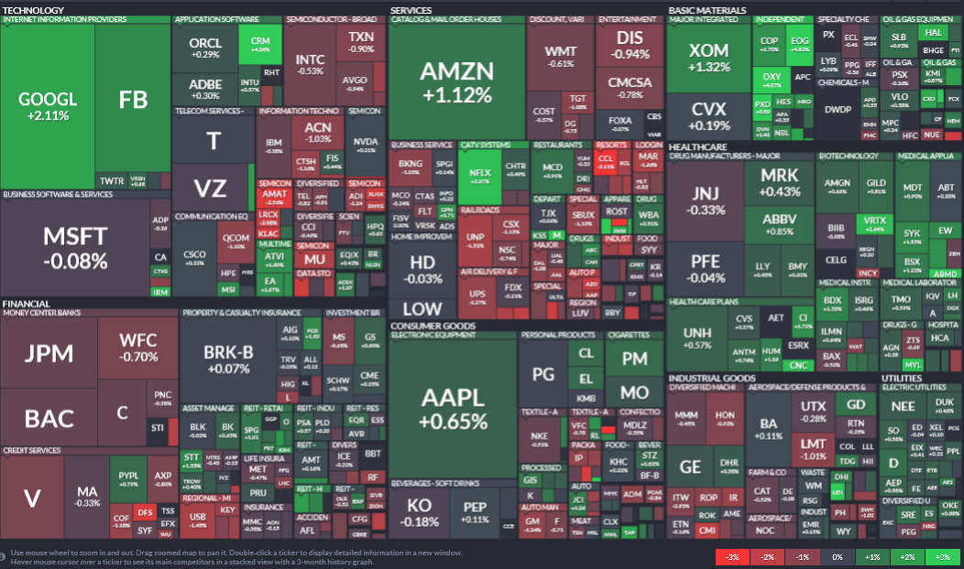
Example of Diversification in Action
While any given company or sector may go down, others may go up
Notes:
The way funds diversify is by holding many different stocks, bonds or other securities.
Diversification helps investors because if one company or sector experiences a decline in value, others may go up.
This graphic shows the S&P 500 stocks over a single day and is merely an example of holdings that a hypothetical fund tracking the S&P 500 index might have.
For example, if industrial stocks in the lower right have a down day, perhaps gains in your tech stocks and financial stocks on the left side will insulate your overall portfolio – that’s the theory of diversification. (Snapshot on January 6, 2020 S&P 500. Source: FinViz https://finviz.com/map.ashx)

Slide 33

Investment Fees Impact Your Return
Notes:
Fees are very important and can impact your investment return.
You should research and think about them before committing to any investment.

Slide 34
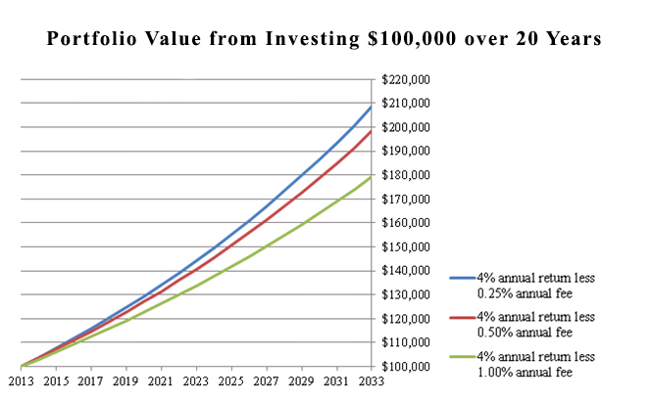
Impact of Fees
Notes:
We have a bulletin on Investor.gov that shows the impact of various fees on a $100,000 portfolio over 20 years.
What you earn after 20 years is shown on this chart, with the blue line showing a quarter-point annual fee, the red line in the middle showing a half-point fee, and the green line on the bottom showing a full point fee.
You can see the relatively small fee differences add up to tens of thousands of dollars over 20 years.
For example, when you consider funds, there are typically two types of funds:
Actively managed funds are funds that rely on the skill of an investment professional to buy and sell securities, often in an attempt to perform better than the market.
Index funds follow a more passive strategy that attempts to match the performance of a specific market index or benchmark -- like the S&P 500 or the Russell 2000 Index -- rather than try to beat it.
Actively-managed funds typically have higher fees, and so they need to have higher returns that make up for the higher fees in order for you to make the same amount of money.

Slide 35
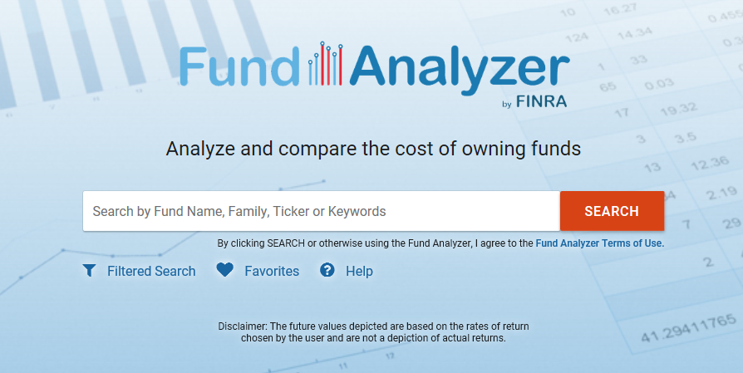
FINRA Fund Analyzer
www.finra.org/fundanalyzer
Notes:
And when you want to compare the fees and expenses of various funds, FINRA has a free tool – the Fund Analyzer – on its website, FINRA.org.
It offers information and analysis on over 30,000 mutual funds, exchange-traded funds (ETFs), and money market funds, including the fees charged by funds.

Slide 36

Investing Apps
Mobile platforms that help you save and invest
Some apps allow you to buy or sell securities or get advice on investing
Make sure your investment app is a registered investment firm
Notes:
Investing apps have become popular especially with younger people.
Many apps allow you to buy or sell securities or get investment advice. Some apps allow you to set an investment strategy, often based on your time horizon and risk tolerance.
If you plan to use an investing app, make sure you are dealing with a registered investment firm. We’ll talk about how you can do that in just a few minutes.

Slide 37
Investing Apps: What to Keep in Mind
Apps may give new investors access to complex or high-risk products or strategies – understand before you invest
Human interaction or assistance may be limited to online queries
Fees may seem low, but find out how costs and commissions work
Apps may encourage some to over-trade through gamification of trading and instant notifications on stock moves
Notes:
Investing apps have become increasingly popular especially with younger people. Many apps allow you to buy or sell securities or get investment advice. Some apps allow you to set an investment strategy, often based on your time horizon and risk tolerance.
When using investing apps, here are some things to be aware of:
Some apps may give inexperienced users access to complex or high risk products or strategies, like options trading, where you can lose more money than you invest
Some firms may be difficult to reach if you have questions – some have no customer service phone support and only offer email assistance, which can take time for responses
Many apps advertise no fees or low fees, but check the fine print and make sure you are comfortable with how the firm is compensated.
Keep in mind that some apps use entertaining user interfaces with notifications when stocks go up or down and fun graphics after transactions, and these can encourage over-trading or even encourage investors to treat investing more like gambling.
If you plan to use an investing app, make sure you are dealing with a registered investment firm by doing a free background check on Investor.gov.

Slide 38
Planning for Retirement
Notes:
Now let’s talk about saving and investing for retirement.

Slide 39
Tax-Advantaged Retirement Accounts
 | Employer-Sponsored Plan 401(k) / 403(b) / 457(b) | Individual Retirement Account (IRA)
Maximum contribution | $19,500 annually (50+ may add $6,500) | $6,000 annually (50+ may add $1,000)
Investment options | Choice of investments, typically mutual funds | Can invest in mutual funds, individual stocks and bonds, annuities, certain real estate
How it grows | Your contributions, plus possible employer matches, grow tax free | Self-directed account based on your contributions, which grow tax-free
Notes:
First of all, the IRS provides tax incentives to save for retirement.
Three common employer-sponsored retirement accounts are 401(k)s, 403(b)s and 457(b)s. Private companies may offer a 401(k), while 403(b)s are typically offered by public schools and certain non-profits and hospitals, and 457s are generally offered by state and local governments. With these employer retirement accounts, your contributions can be deducted from your paycheck. The IRS limits your annual contributions to an employer-sponsored plan to $19,500 (and an additional $6,500 for those over 50).
Whether or not your employer offers a retirement savings plan, you can contribute to an IRA. (If you do have an employer-sponsored plan, then the IRA’s tax advantages may be limited by your income. There are also income limits for Roth IRAs. Consult the IRS or a tax professional for more information.) The limit for IRA contributions is $6,000 annually (and an additional $1,000 for those over 50).

Slide 40
Traditional vs. Roth Contributions
Traditional | Roth
Tax break now… Your money goes in before taxes Lowers your taxable income Money grows tax free Your money will be taxed when you withdraw it | Tax break later… Your money goes in after taxes Money grows tax free Your money will be tax-free when you withdraw it
Notes:
You may have an option as to which type of tax advantage you receive with your retirement account.
With a traditional option (tax break now, tax hit later) you’ll lower your current year’s taxable income by the amount of your contribution, and the money will grow tax-free until you begin taking distributions in retirement. When you withdraw funds, they will be taxed at your income tax rate at the time.
With a Roth option (tax hit now, tax break later) you will contribute after-tax money (in other words, you will be taxed now at your current tax rate), but then the funds will grow tax-free and face no future taxation.

Slide 41
Target Date/Lifecycle Funds
The name of the fund often refers to its target date
Notes:
One strategy in retirement investing is choosing a Target Date (or Retirement Date) Fund that automatically adjusts your mix of investments – or asset allocation – over time from a more aggressive “return seeking” strategy early on to a more conservative “asset preservation” strategy as you approach retirement.
Target date funds are mutual funds that hold a mix of stocks, bonds, and other investments, and they are designed to be long-term investments for individuals with particular retirement dates in mind.
The name of the fund often refers to its target or retirement date. For example, you might see funds with names like “Portfolio 2030” or “Retirement Fund 2050.”
Target date funds are often available through 401(k) plans, and some 401(k) plans may make these the default investment for participants.
Consider the fees before selecting any fund, including target date funds.

Slide 42
Tips for Your Retirement Account
Don’t delay
Start contributing as soon as you can, then increase contributions as your earnings increase
Take advantage of employer matching
Your employer may match your contributions up to a certain level – it’s free money… and it’s part of your compensation!
Contribute consistently
Keep contributing in both up and down markets
Pay attention to fees
Your retirement plan may have funds that charge different levels of fees
Notes:
Here are some tips for saving for retirement:
Start investing as soon as you can and let the power of compounding work for you. Consider increasing your contributions as your earnings increase.
Max out your match from your employer if your employer matches your contributions, if you can afford to do so. It’s free money – and it’s part of your compensation.
Keep contributing whether the markets are up or down. Keep in mind that in down markets, the prices of the shares you’re purchasing are lower so your money is buying more shares. As the market recovers, the value of your portfolio increases as well.
Always pay attention to the fees, especially if you have a menu of fund choices in which you can invest your retirement contributions. An investment with high costs must perform better than a low-cost investment to generate the same returns. (Remember, Fund Analyzer.)

Slide 43
Switching Jobs?
Keep some or all in former employer’s plan - If permitted
Transfer to new employer’s retirement plan - Transfer your account balance directly to your new employer’s plan if it accepts such transfers
Roll over to an IRA - Transfer your account balance to an IRA Rollover Account
Lump sum distribution - WARNING: You will owe taxes and pay a penalty if you take money out before the age of 59½
Notes:
When you switch jobs, you may be able to keep your retirement account in the plan of your former employer, or you may consider transferring it to your new employer’s retirement plan or rolling it over to an IRA. Transfers and rollovers should be non-taxable events if completed within 60 days.
Remember to pay attention to fees when you make those decisions.
And if you are considering a lump sum distribution or withdrawal before you are 59 1/2, be prepared to pay taxes and penalties on that money. Consider other alternatives.

Slide 44
Tips to Avoid Fraud
Notes:
When you’re investing, you need to take steps to avoid scam artists who will try to steal your money.

Slide 45

Fraud in the Movies
Wolf of Wall Street Clip
Notes:
Here’s how investment fraud is depicted in the movies.
Let’s look at a clip from the movie Wolf of Wall Street. What are some of the tactics he used?

Slide 46
Red Flags of Fraud
Guaranteed Returns!
Sounds too good to be true, such as promises of high returns with little or no risk
Pressure to buy RIGHT NOW
Lack of documentation, such as:
  No public filings
  No statements
  No prospectus
Unlicensed or unregistered salesperson
Huge Upside, No Risk!
Notes:
Here are some red flags of fraud to keep an eye out for:
Many scams sound too good to be true – trust your instincts. If the offer promises high returns with little risk, it’s probably a scam.
Don’t be pressured to buy right now. No legitimate investment requires a quick decision. Wait until you have the time to do your own due diligence.
Watch out when there’s no prospectus, offering memorandum, or no statements or public filings.
Make sure any investment professional you use is licensed or registered – Check Investor.gov.

Slide 47

Unsolicited Offers
The salesperson or promoter approaches you, not the other way around
Examples:
  Cold call
  Email
  Social media
  Radio and newsletters
  Direct mail
  Free dinner seminar
How to respond: Be cautious! Do your own homework if you’re curious or simply walk away
Notes:
Another red flag of fraud is an unsolicited offer to invest that can come out of the blue. Consider why a stranger would need to pitch the investment to you if it’s really such a good investment, and think about what that stranger’s motives might really be. You should tread carefully when you didn’t seek out the investment or the salesperson. Do your homework if you’re tempted by the offer, or better yet, walk away. The best scenario is when you do your own research and choose where to invest.
Here are a few other things to remember so you don’t get scammed:
Never pay for investments with credit cards, gift cards, or wire transfers.
Don’t ever pay a fee in order to claim a “winning” or other proceeds. That’s not how legitimate lotteries or investment opportunities work.
If someone claims to be from the government, and you did not initiate the contact, call the agency and find out if they work there.
Be cautious when asked to share personal information, such as passwords, credit card numbers and account numbers.

Slide 48
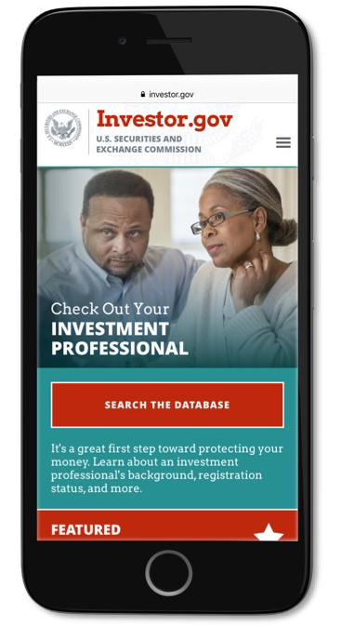
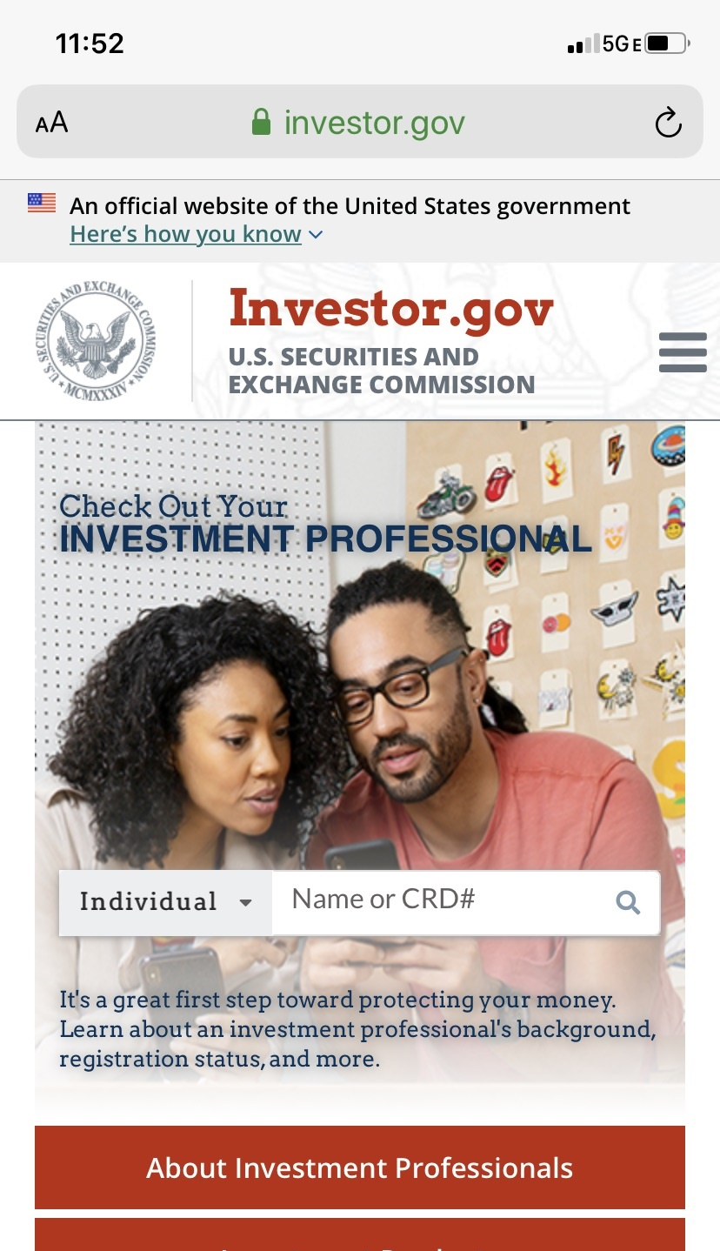
Check Any Investment Professional
Check on Investor.gov:
License/registration
Employment history
Important disclosures
Notes:
The first step to protecting your hard-earned money from investment scams is making sure you’re dealing with a licensed/registered investment professional.
Before you use an investment professional—including anyone selling you an investment—make sure you check them out on Investor.gov.
Typing their name into the “Check Out Your Investment Professional” box on our website will show you whether they are licensed and registered. You can also see their employment history, including which firms they have worked for and how many years of experience they have, and if they seem to be jumping from firm to firm, which can also be a red flag. You’ll also be able to see important disclosures.
Let’s learn more about what to check for and what the disclosures include.

Slide 49
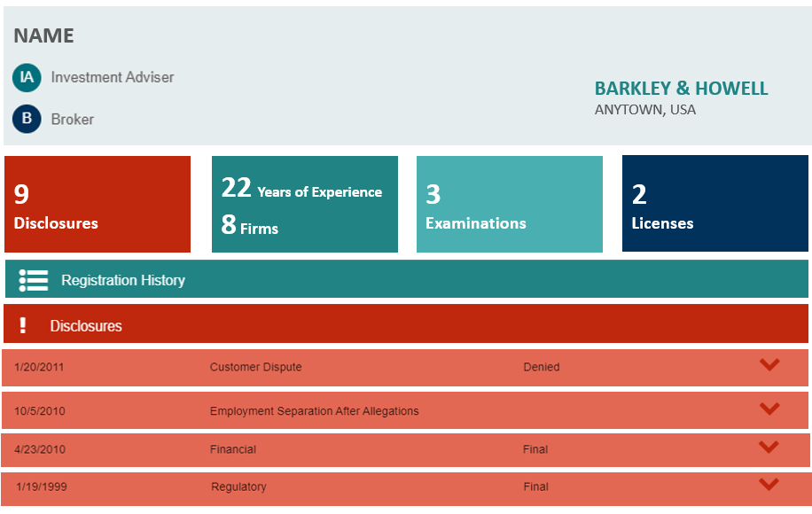
Disclosure Events
JOHN Q. PUBLIC
Notes:
Here’s an illustration of what we would see when we click “Get the Full Report.” In this example, we see multiple disclosures. Disclosure events include certain criminal charges and convictions; formal investigations and disciplinary actions initiated by regulators; customer disputes and arbitrations; and financial disclosures, such as bankruptcies. We would also be able to see their registration history, which is a history of which firms they have worked for, including how long they worked for each firm.

Slide 50
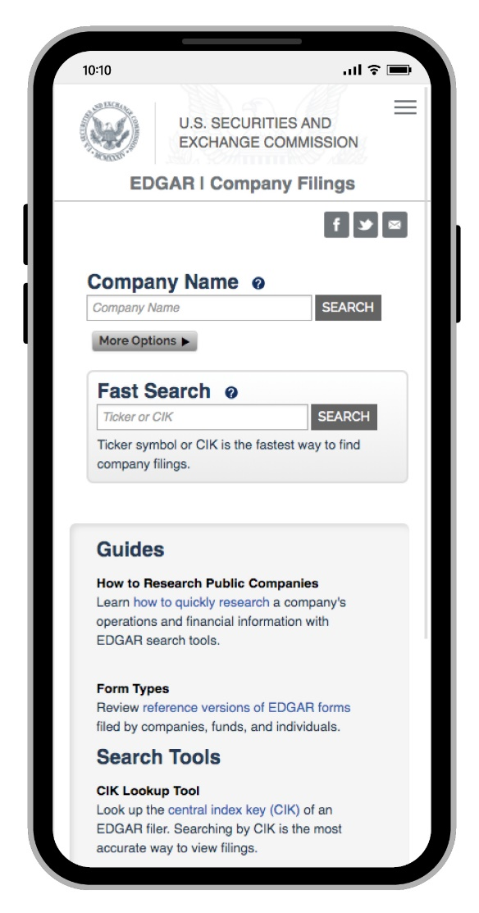
Research Any Investment Product
Check EDGAR:
Is the product registered
with the SEC?
Scams often involve unregistered companies
EDGAR has important information about companies
Notes:
In addition to doing your due diligence on the investment professional, you can also research the particular investment you are considering.
We have a tool called EDGAR that allows you to research publicly-traded companies, mutual funds and variable annuities. EDGAR is SEC’s the online database of corporate filings. If the company you’re looking up is not on EDGAR, you may need to do more research because it may not be registered with the SEC. This doesn’t mean that the investment is a scam, but it’s good to keep in mind that a lot of scams involve unregistered companies – the ones you won’t find on EDGAR.
You can learn important information from the filings that these companies are required to make to the SEC, such as:
the company’s registration statement,
its periodic disclosures with the SEC,
stock holdings of officers and directors,
and the company’s audited financials.
The main EDGAR page includes a tutorial on how to quickly research a company’s operations and financial information.

Slide 51
SEC Resources

Slide 52
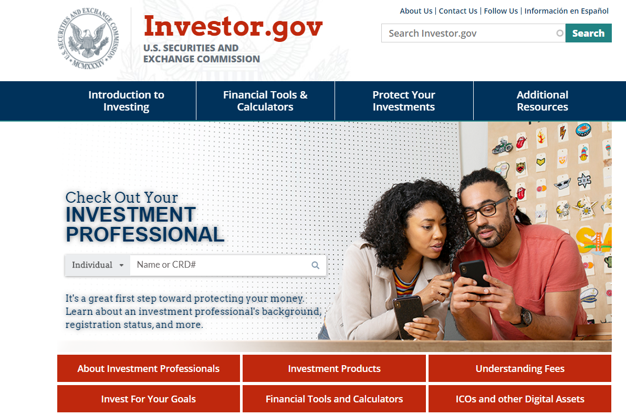
Investor.gov
Notes:
Just about everything we covered today in this presentation is derived from resources on Investor.gov.

Slide 53
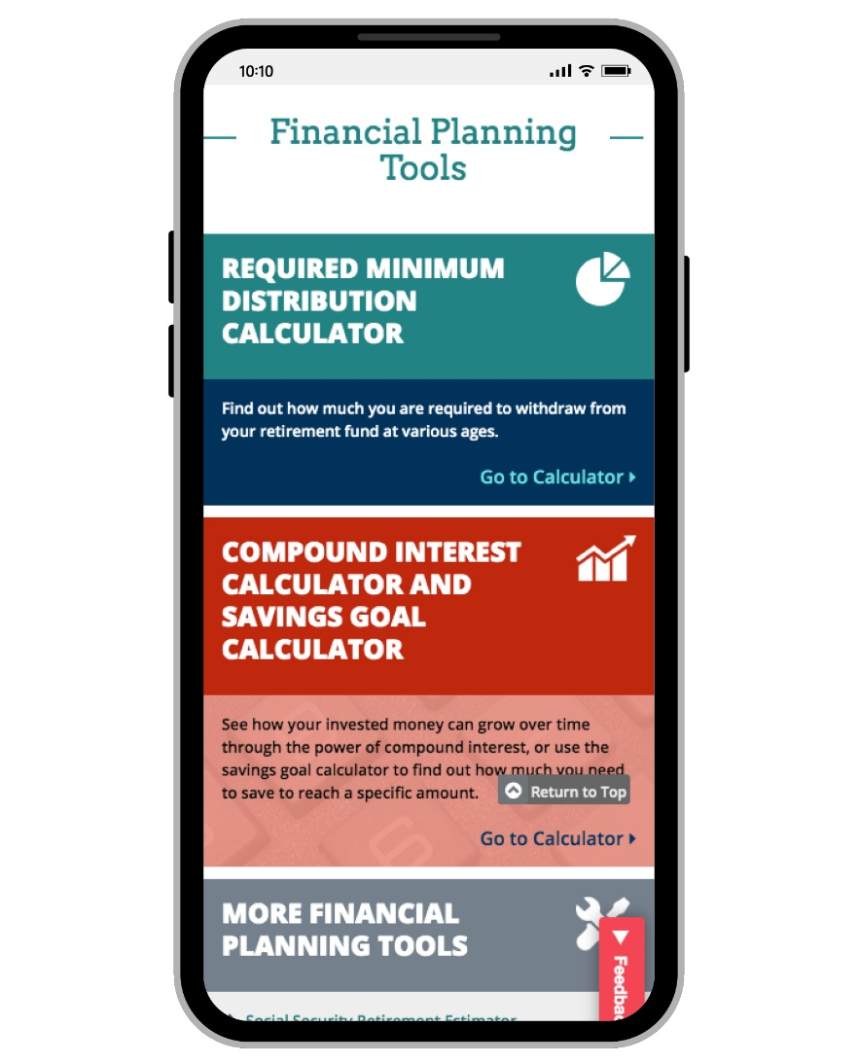
Financial Planning Tools
Notes:
And when you want to figure out how compound interest will work for you, this is one of the most popular tools on our website -- our Compound Interest Calculator -- which allows investors to see how their money can grow over time.
It lets you plug in an “initial investment” amount, plus the amount you plan to contribute periodically. Then you can plug in the interest rate you expect to earn.

Slide 54
Investor Alerts and Bulletins
Characteristics of Mutual Funds and Exchange-Traded Funds
Environmental, Social and Governance (ESG) Funds
Understand the Significant Risks of Short-Term Trading Based on Social Media
Fractional Share Investing
Index Funds
Notes:
Investor.gov has hundreds of timely investor alerts and bulletins on emerging risks to investors, fraudulent tactics, and investment topics.
Here are just a few examples. You can search by keyword.

Slide 55



How to Reach Us
Office of Investor Education and Advocacy
U.S. Securities and Exchange Commission
Investor Assistance: 800-732-0330 | help@sec.gov
Investor.gov
www.facebook.com/SECInvestorEducation
@SEC_Investor_Ed

