Slide 1

How Should I Know? Lack of Confidence Biases Stock Market Expectations Toward Zero
Alycia Chin*| Eric M. VanEpps | Brian Scholl| Steven Nash
*Presenting author
This presentation is provided in the author’s official capacity as a staff member of the Office of the Investor Advocate at the Securities and Exchange Commission (SEC) but does not necessarily reflect the views of the Commission, the Commissioners, or other members of the staff.

Slide 2

Stock Market Expectations
What do you think is the percent chance that 12 months from now, on average, stock prices in the U.S. stock market will be higher than they are now?

Slide 3


Stock Market Expectations
What do you think is the percent chance that 12 months from now, on average, stock prices in the U.S. stock market will be higher than they are now?
Answers to such questions correlate with: Stock holdings, stock purchases, and size of trades¹
Similar questions show up in many national surveys²
¹ Dominitz & Manski, 2007; Giglio et al., 2021; Hurd 2009; Hurd, Van Rooij, & Winter, 2011; Vissing-Jorgensen, 2003
² NY Fed, Michigan Survey of Consumers, De Nederlandsche Bank, etc.

Slide 4


Literature
Two observations from the literature
Stock market expectations questions are difficult to answer
Stock market expectations are “pessimistic”
In nationally representative surveys, more than half of respondents say they have “no idea about the chance” or “no one can know the chance,” and many give “50/50” responses¹
Households state a lower probability of a stock market increase than historical performance would warrant²
¹ Chin & Bruine de Bruin, 2018
² Bruenig et al., 2021; Hurd, 2009; Kézdi & Willis, 2009

Slide 5


Our Paper
We posit a new relationship that ties these two facts together:
Most
questions ask
about the stock
market going up.
This leads to the
appearance of
pessimism.
Lack of confidence in ability to forecast stock market movements
Reported probabilities are biased toward 0%

Slide 6

Outline of the talk
Study 1
Show that stock market expectations are pessimistic
Study 2
Show that stock market expectations are pessimistic biased toward zero, using a framing manipulation (stock market higher or lower)
Study 3
Manipulate confidence and affect expectations

Slide 7


Study 1
NY Fed Survey of Consumer Expectations – nationally representative panel of approximately 1,300 household heads (with repeat participation for up to 12 months)
Data ranges from
52,941 forecasts from
10,560
individuals
May 2014
July 2023

Slide 8
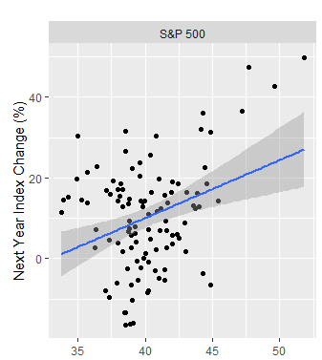

Relationship between expectations and stock market movements
The S&P 500 index increased following 74.1% of survey response dates
The proportion of respondents providing an expectation greater than 50% ranged from 23% to 48% across survey months
  Number of months in which the majority of participants reported a probability greater than 50% that the stock market would increase = 0

Slide 9

Study 2: Framing Effect on Expectations
Framing Manipulation
Data: Monthly panel survey
What do you think is the percent chance that [1 month/12 months] from now, on average, stock prices in the U.S. stock market will be [higher/lower] than they are now?
July 2020
June 2021
An “onboarding” survey conducted in July 2020 of N=4,602
After that, subsamples of 1,200-1,500 respondents were surveyed monthly
Oversampled those with investments
Respondents
reported expectations
for both 1 and 12
months
21,889
total responses

Slide 10
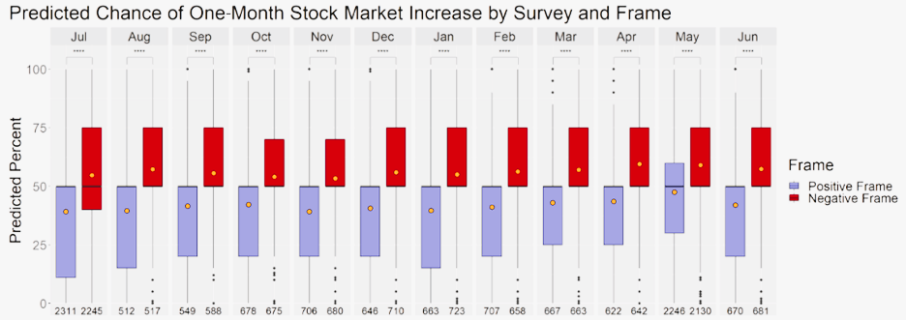


Framing Effect in Expectations
39.3%
Average chance of increase in positive frame
54.8% Average chance of an increase in negative frame = (100-chance of decrease)

Slide 11

Study 3: Manipulating
Confidence
Surveys conducted by the New York Federal Reserve Bank have asked participants to predict the likelihood that U.S. stock prices will be higher in one year.
High confidence: Participants often find this question to be difficult, but actually, their predictions are usually quite predictive; most predictions are related to actual stock market performance.
Low confidence: Participants often find this question to be difficult, and indeed, their predictions are usually quite inaccurate; most predictions are far away from actual stock market performance.
2x2 between-subjects
Confidence
Framing

Slide 12

Study 3 Methods
Confidence manipulation check
How easy does it seem to make accurate predictions about stock market movements?
What do you think is the percent chance that 1 month from now, on average, stock prices in the U.S. stock market will be [lower/higher] than they are now, even by a fraction of a percentage point? (Please enter a number between 0 and 100 below).
Not at all easy
Very easy
How confident are you about your ability to predict future stock market movements?
Not at all confident
Very confident

Slide 13
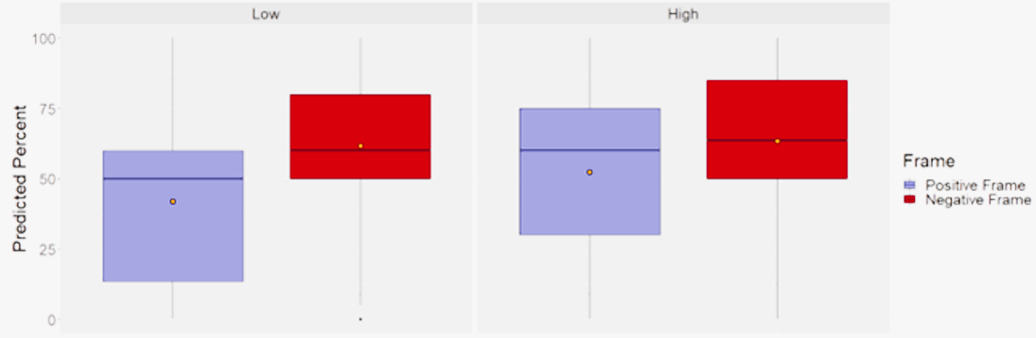
Results
Gap caused by framing manipulation narrows in high confidence condition
Participants seeing the positive framed question were more optimistic in the high confidence condition
2.16
2.64
Mean confidence in
low confidence
Mean confidence in
high confidence

Slide 14




Discussion
Confidence in one’s ability to forecast the stock market can affect reported probabilities
  Possibly, it is difficult to recruit evidence for a focal event (stock market up or down), which biases probabilities toward 0%
Offers a
novel explanation
Not consistent with valence-framing effects
(Maybe) applicable
to a host of other subjective expectations
for “pessimistic” expectations shown in economic literature
we find the opposite!

Slide 15

Thank you! Questions?
sec.gov/advocate/positier

