Slide 1
EDGAR NEXT
KICK-OFF WEBINAR
SEC EDGAR Business Office (EBO)
October 23, 2024 | 2:00 – 3:30 pm

Slide 2
disclaimer
This presentation represents the views of the staff of the EDGAR Business Office. It is not a rule, regulation, or statement of the Securities and Exchange Commission (SEC or Commission). The Commission has neither approved nor disapproved its content. As with all staff statements, this information has no legal force or effect: it does not alter or amend the applicable law, and it creates no new or additional obligations on any person.

Slide 3
Agenda
Adopting Release
Compliance Dates
Purposes
What Hasn't Changed
Key Changes
Filer Transition to EDGAR Next
Prepare
Filer Support for EDGAR Next
Questions & Answers

Slide 4
Adopting release
The SEC adopted rule and form changes to EDGAR filer access and account management (EDGAR Next) on September 27, 2024.
The SEC also adopted related changes to Volume I of the EDGAR Filer Manual that will be effective March 24, 2025.

Slide 5
compliance dates
Compliance with all EDGAR Next rule and form changes is required on September 15, 2025, in order to file on EDGAR.
Filers must take action to transition to and come into compliance with EDGAR Next.
Enrollment is a simplified process for filers to transition to EDGAR Next.
Filers enroll on the dashboard; they do not "enroll" on Form ID.

Slide 6
compliance dates
Filers have six months to enroll in EDGAR Next before the EDGAR Next compliance date, from March 24, 2025 to September 12, 2025.
Filers have three months to enroll in EDGAR Next after the compliance date, from September 15, 2025 to December 19, 2025 (but filers who do not enroll or gain access by submitting amended Form ID by September 15 will be unable to file until they enroll).
In addition, please be aware that compliance with amended Form ID is required as of March 24, 2025.

Slide 7
Purposes
Improve the security of EDGAR
Enhance filers' ability to manage their EDGAR accounts
Simplify the procedures for accessing EDGAR
Modernize connections to EDGAR

Slide 8
What hasn't changed filer obligations
EDGAR Next changes EDGAR access and account management processes only.
It does not change the contents or requirements of any filing or submission type or any disclosure obligation.

Slide 9
KEY Changes
Let's review some key changes under EDGAR Next:
Login.gov individual account credentials
Account administrators to manage filers' accounts on a dashboard
Amended Form ID
Please review the adopted rule and form changes to EDGAR filer access and account management (EDGAR Next) for a discussion of all relevant EDGAR Next changes.

Slide 10
Key Changes LOGIN.GOV credentials
Each individual who seeks to access EDGAR must present Login.gov individual account credentials.
Note that you need Login.gov credentials to access Adopting Beta as well.

Slide 11
Key Changes LOGIN.GOV credentials
Obtain credentials from Login.gov by going to the homepage of the Beta EDGAR Filer Management website (https://filermanagement-bravo.edgarfiling.sec.gov/) and selecting "Sign in with Login.gov."
You will be redirected to Login.gov to create credentials.
You are not creating test credentials.
The Login.gov credentials you create will remain valid.
Consider creating credentials that you will use for EDGAR in the future.

Slide 12
Key changes LOGIN.GOV CREDENTIALS
Provide an email address to Login.gov that matches the email address you intend to use for EDGAR.
EDGAR uses the email address provided to Login.gov for identification and notification, and the email address is visible to others on the dashboard.
Consider providing to Login.gov a different email address than that used for personal purposes.

Slide 13
Key changes LOGIN.GOV CREDENTIALS
You will be prompted to select a multifactor authentication method that you must complete each time you present your Login.gov credentials to EDGAR.
Review the several different options for multifactor authentication available on Login.gov and select one.

Slide 14


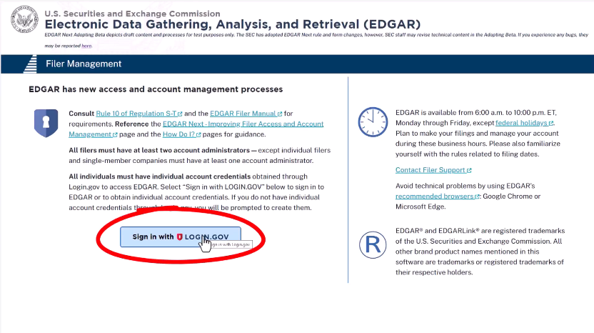
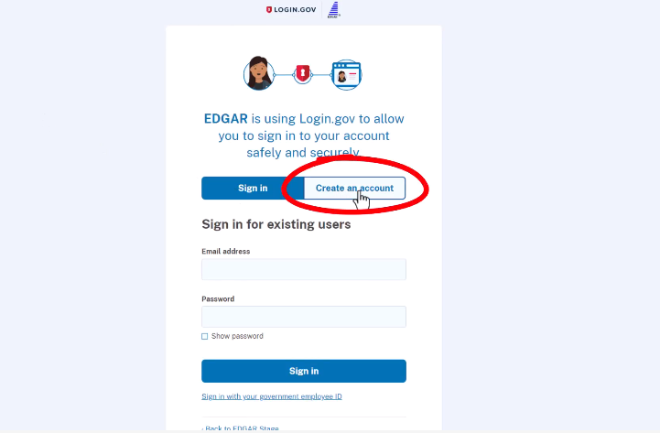
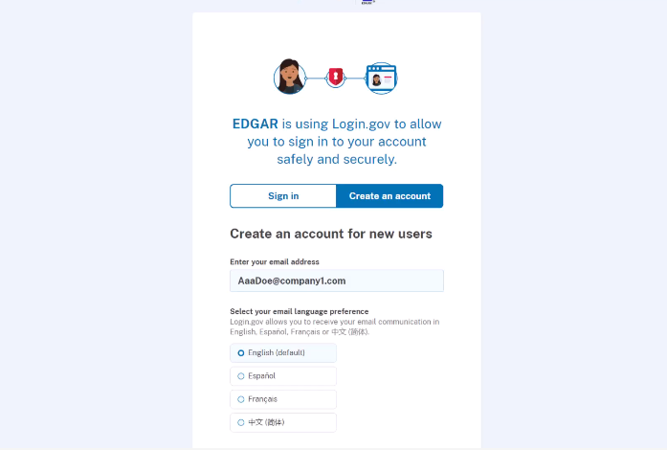

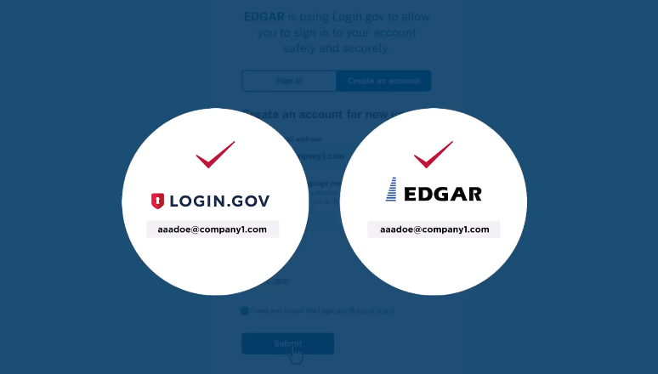

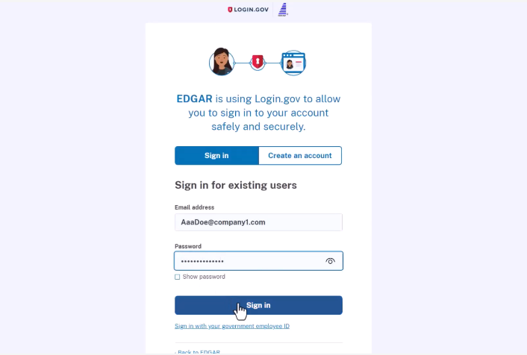
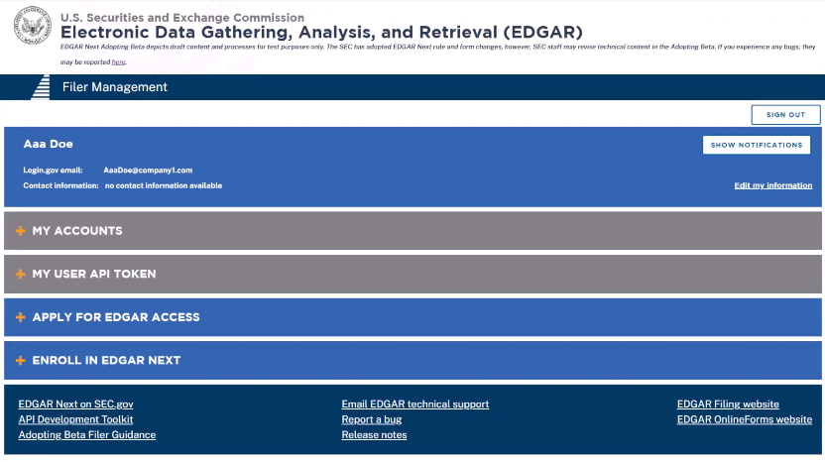
graphic OUTLINING how FILERS NEED TO CREATE A LOGIN.GOV ACCOUNT IN ORDER TO ACCESS EDGAR’S FILER MANAGEMENT DASHBOARD
Key changes LOGIN.GOV CREDENTIALS

Slide 15
Key changes ACCOUNT ADMINISTRATORS
Filers must authorize account administrators to manage their accounts.
Minimum number of account administrators:
Individual and single-member company filers:
At least one (1) account administrator is required.
We encourage authorizing at least two (2) account administrators in case one is unavailable.
All other filers:
At least two (2) account administrators are required.
Maximum number of account administrators for any filer: 20.

Slide 16
KEY Changes account administrators
Account administrator actions on the dashboard:
Adds and removes individuals authorized to act for the filer, including users, technical administrators and other account administrators
Generates or creates custom CCC for the filer
Performs filer's annual confirmation of account
Delegates authority to file to other EDGAR accounts (and may remove delegations)
Creates and edits groups of users
Can also be a technical administrator (but not also a user)

Slide 17
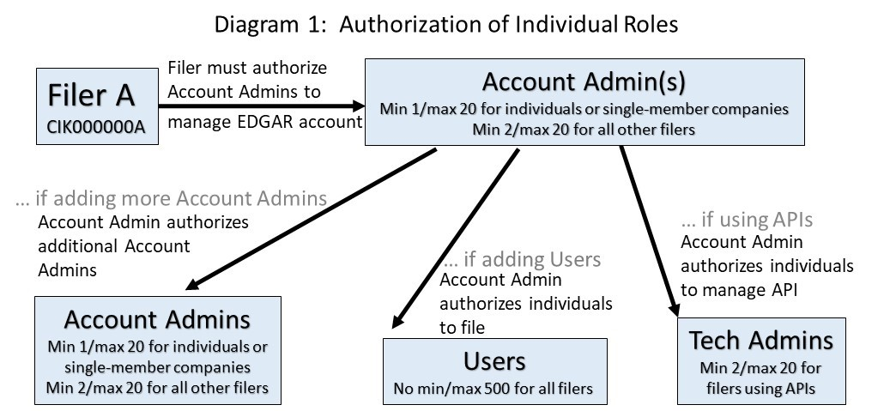
Key changes account administrators

Slide 18
Key changes amended Form ID
Form ID, the application for EDGAR access, is being amended to capture authorization of account administrators and other information and to make the form more user-friendly.
Compliance with Amended Form ID is required March 24, 2025.
Amended Form ID must be completed on the dashboard.

Slide 19
Key changes amended Form ID
Amended Form ID must be completed by:
A prospective filer seeking to open a new EDGAR account;
A filer that has lost electronic access to its EDGAR account;
A filer that is the legal successor of the filer named on the existing CIK account but did not receive access from that filer; and
A "paper filer" seeking access to its existing account for the first time to file electronically.

Slide 20
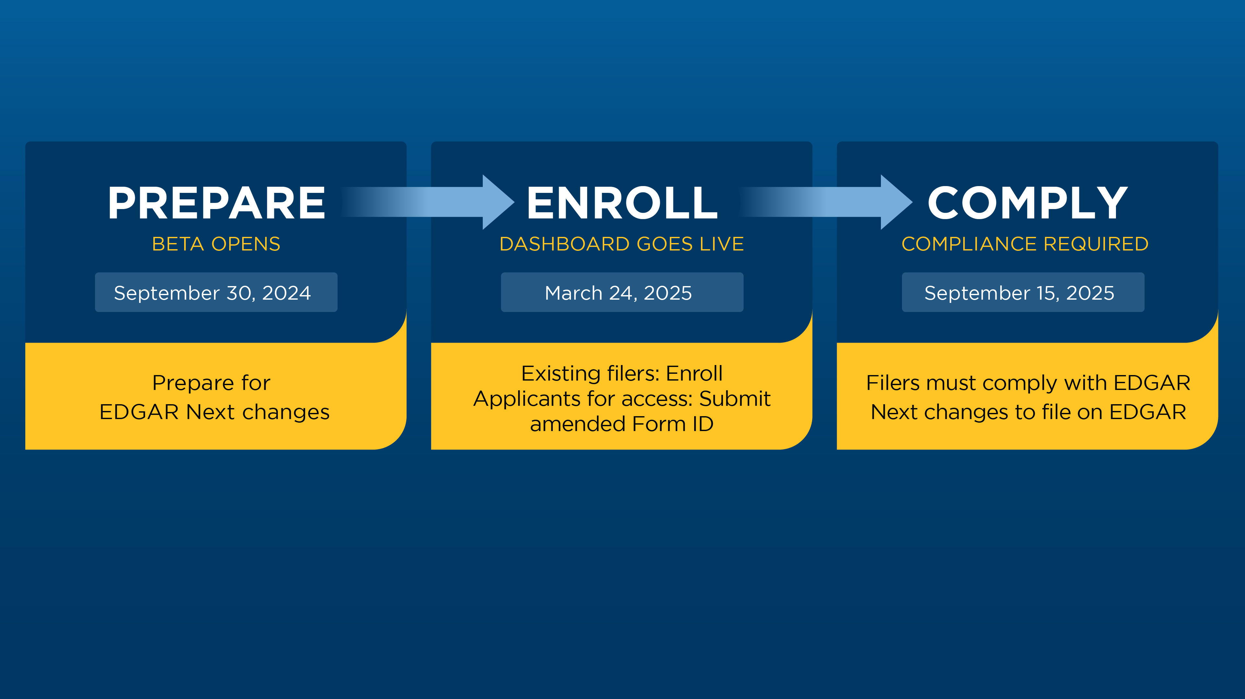

filer transition to edgar next
A more detailed infographic highlighting how filers can prepare, enroll, and comply with the SEC’s changes to EDGAR system filer access and account management is linked and available for download on www.sec.gov/edgar-next.
20

Slide 21
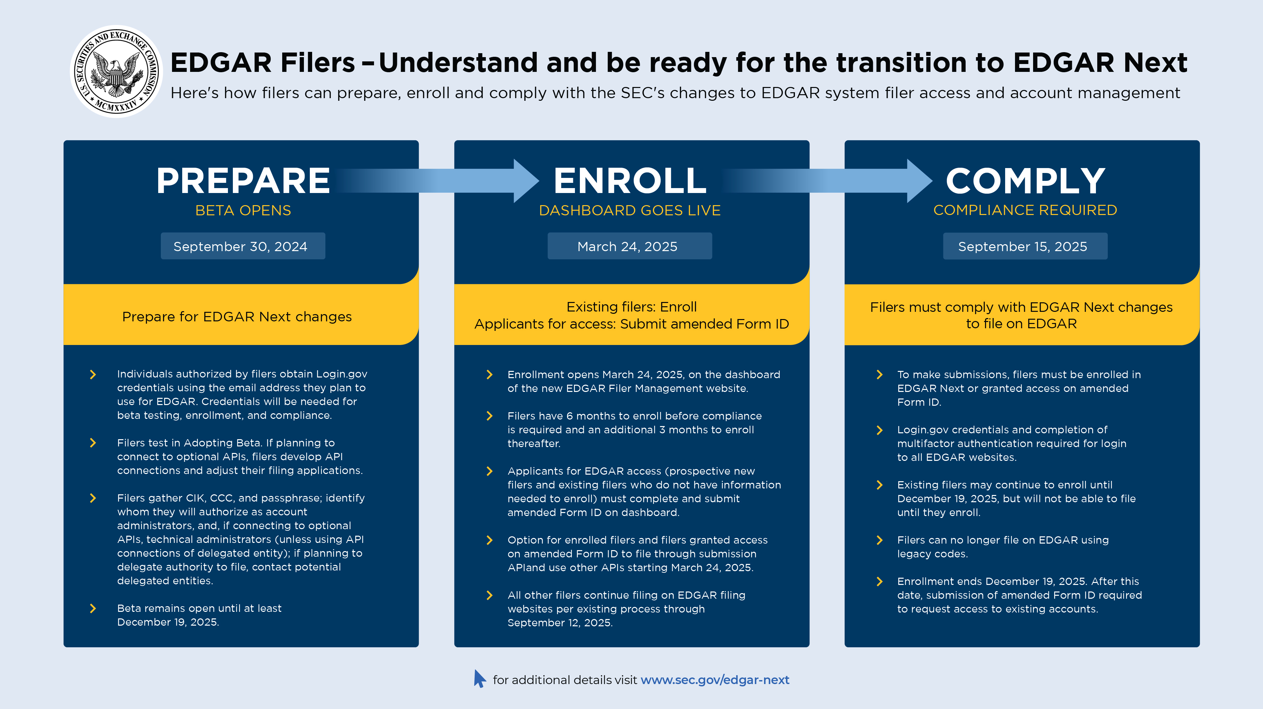
graphic OUTLINING how filers can prepare, enroll, and comply with the SEC’s changes to EDGAR system filer access and account management.
21

Slide 22
prepare
BETA OPENS
SEPTEMBER 30, 2024

Slide 23
Prepare adopting beta
Test in the Adopting Beta environment.
Adopting Beta is accessible through the EDGAR Next—Improving Filer Access and Account Management webpage on SEC.gov (www.sec.gov/edgar-next).
Individuals who want to access Adopting Beta need Login.gov credentials. See above slides about how to obtain Login.gov credentials.

Slide 24
Prepare adopting Beta
The Adopting Beta reflects the adopted rule and form amendments, and related technical changes.
All three EDGAR filing websites and all APIs are reflected:
EDGAR Filer Management
EDGAR Filing
EDGAR Online Forms
15 optional EDGAR Application Programming Interfaces (APIs)

Slide 25
Prepare Adopting beta
15 optional EDGAR APIs reflected:
Submission API
Submission Status API
EDGAR Operational Status API
Filer Management APIs:
Add Individuals
Remove Individuals
View Individuals
Change Roles
Send Delegation Invitations
Request Delegation Invitations
View Delegations
View Filer Account Information
Generate CCC
Create Custom CCC
Filing Credentials Verification
Enrollment

Slide 26
Prepare adopting beta
Resources for APIs (linked on EDGAR Next webpage – www.sec.gov/edgar-next)
Overview of EDGAR APIs
API Development Toolkit (also linked in Beta)
API Development support Q&A sessions - LIVE (register on www.sec.gov/edgar-next)
Thursday, October 24, 1:00 – 2:00 p.m.
Thursday, October 31, 1:00 – 2:00 p.m.

Slide 27
Prepare adopting beta
Until March 21, 2025, Adopting Beta will reflect EDGAR as it will be live from March 24, 2025 to September 12, 2025 so that filers can prepare for how live EDGAR will be available during that six-month period. (API submissions and functions; current EDGAR access codes for web filing.)
As of March 24, 2025, Adopting Beta will change to reflect EDGAR as it will be live beginning September 15, 2025 so that filers can prepare for how live EDGAR will be available at the September 15 compliance date. (Login.gov credentials for all filing)
Note also that Adopting Beta will be continuously updated throughout this time period to reflect enhancements and fixes.

Slide 28
Prepare adopting beta
Content of Adopting Beta:
NO account information from live EDGAR.
Account information that testers create in Adopting Beta. (Use only fictional information—other than name and Login.gov email address.)
Accounts that testers created in the prior Proposing Beta and Request for Comment Beta (if testers created those accounts).
NO Beta information will carry over to live EDGAR.

Slide 29
Prepare Adopting beta
Submit test Form IDs in Beta to create testing accounts.
Notarization is not required for test Form IDs in Beta
Use fictional information (other than name and Login.gov email)
Consult EDGAR Next Filer Testing Guidance (linked on EDGAR Next webpage):
Step-by-step guidance
To test enrollment, email EDGARNextBeta@sec.gov for test CIKs

Slide 30
Prepare get ready to enroll
In addition to testing in Adopting Beta, filers should prepare to enroll in EDGAR Next.
Enrollment provides a simplified process for filers to transition to EDGAR Next that does not require notarization or presentation of a power of attorney.
Filers enroll on the dashboard by submitting the information requested under "Enroll."
Filers do not and should not attempt to "enroll" on Form ID.

Slide 31
Prepare gather Cik, ccc, passphrase
Filers should prepare to enroll in EDGAR Next by gathering their CIK, CCC, and passphrase.
If the filer has lost its passphrase, the filer can reset the passphrase by following the step-by-step guidance linked on the EDGAR Next webpage: Reset Your EDGAR Passphrase, EDGAR POC Email.
This guidance also demonstrates how to reset the filer's EDGAR POC email address on EDGAR, if necessary.
We encourage filers who do not know their passphrase to reset it as soon as possible to be prepared and have an accurate passphrase available to enroll.

Slide 32
Prepare identify account administrators
Further, filers should prepare by identifying two persons whom they will authorize as account administrators during enrollment. No more than two (2) account administrators can be authorized during enrollment.
Filers should gather the following information to provide during enrollment:
Name
Email address (must match email address to be used in connection with EDGAR)
Business address
Business telephone number
Note that individual and single-member company filers are required to authorize one account administrator but may choose to authorize two. All other filers are required to authorize two account administrators.

Slide 33
Prepare determine annual confirmation quarter
Filers should also prepare by deciding which annual confirmation date they will select during enrollment. During enrollment, the filer will be asked to indicate the quarter-end date for annual confirmation.
Each filer, through an account administrator, must confirm the accuracy of its account once per year.
The filer can select the quarter-end date by which its account administrator will perform annual confirmation.
Quarter-end dates that can be selected are March 31, June 30, September 30, or December 31.
The annual confirmation quarter can be changed after enrollment by performing enrollment in an earlier quarter, making that quarter the confirmation date going forward.

Slide 34
Prepare person authorized to enroll
Each filer should prepare for enrollment by authorizing one person to enroll it.
Only one person can enroll each filer.
The person who enrolls the filer does not need to be one of the account administrators, but the person can be an account administrator if the filer chooses.
Filers should coordinate with individuals who typically act for filers on EDGAR to ensure all individuals are aware of who will enroll the filer.

Slide 35
Prepare person authorized to enroll
The person authorized to enroll the filer should prepare:
Login.gov credentials: The person who will enroll the filer should prepare by obtaining Login.gov individual account credentials needed to access the dashboard.
All information needed to enroll: The filer should provide the person with the CIK, CCC, and passphrase; information regarding the filer's account administrators; and the filer's selected annual confirmation quarter.

Slide 36
Prepare what is not required to enroll
What is not needed to enroll:
A power of attorney is not needed.
Notarization is not required.

Slide 37
Filer Support for edgar next
EDGAR Next webpage on SEC.gov - www.sec.gov/edgar-next
SEC Staff assistance to understand, prepare and transition to EDGAR Next
Numerous linked help documents, including:
EDGAR Next Filer Testing Guidance
Overview of EDGAR APIs, EDGAR API Developer Toolkit
EBO Information for Filers, Reset Your EDGAR Passphrase, EDGAR POC Email
EBO Information for Filers, Enroll in EDGAR Next: Individual/Section 16 Filers

Slide 38
Filer Support for edgar next
Webinars (register at www.sec.gov/edgar-next/#support)
EDGAR Next Kick-off Webinar Series (LIVE)
November 7, 2024: 11:00 a.m. – 12:30 p.m.
API Development support Q&A Sessions (LIVE)
Instructional Video Series (linked on www.sec.gov/edgar-next)
EDGAR Next Instructional Video Series – SEC’s YouTube Channel
Filer Support contacts (listed on www.sec.gov/edgar-next)
Email support: EDGARNextBeta@sec.gov
Telephone support: (202) 551-8900, Option #2

Slide 39
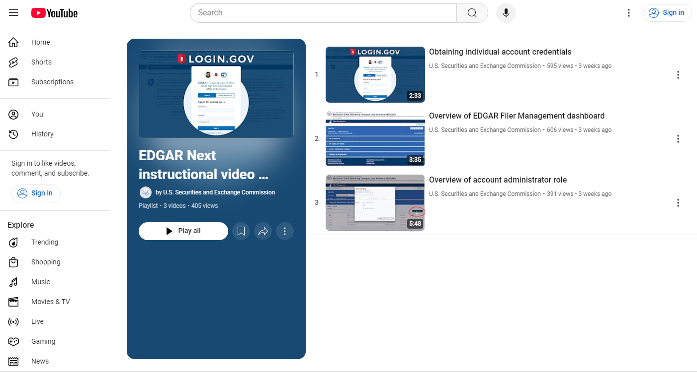

Filer Support for edgar next instructional video series
www.youtube.com/user/SECviews
Select “Playlists” > “EDGAR Next Instructional Video Series”

Slide 40
Questions & Answers
PLEASE TYPE YOUR QUESTIONS IN THE CHAT

